Slide 1
BUSINESS RESEARCH METHODS
UNIT- 3
BY
ARTI (MBA)
HINDU INSTI TUTE OF MANAGEMENT & TECHNOLOGY, ROHTAK

Slide 2
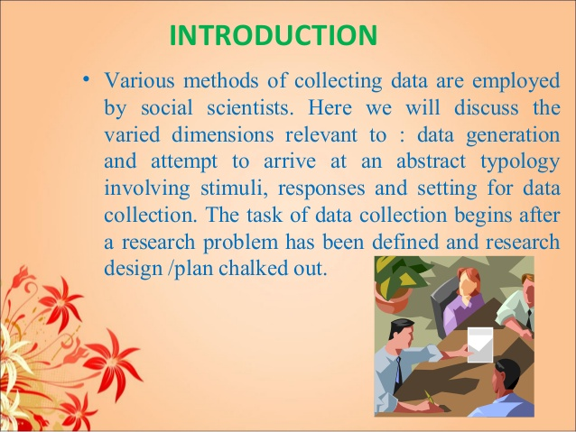

Slide 3
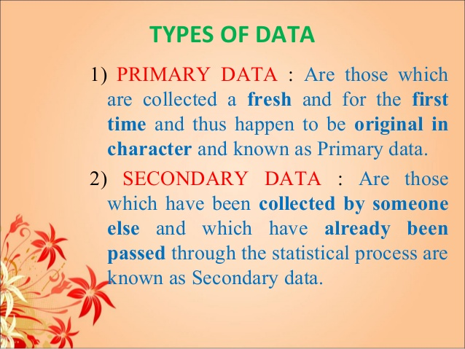

Slide 4
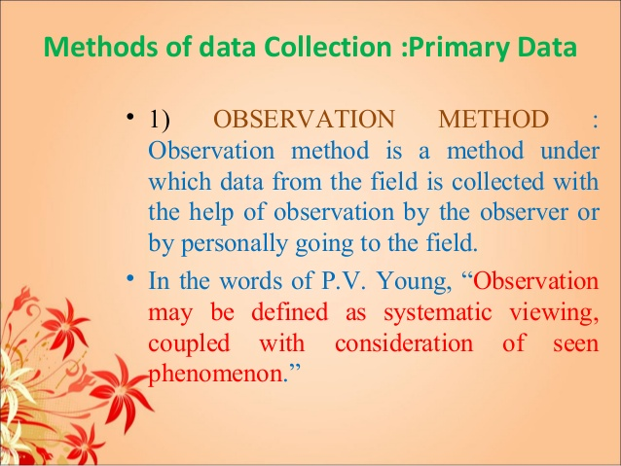

Slide 5
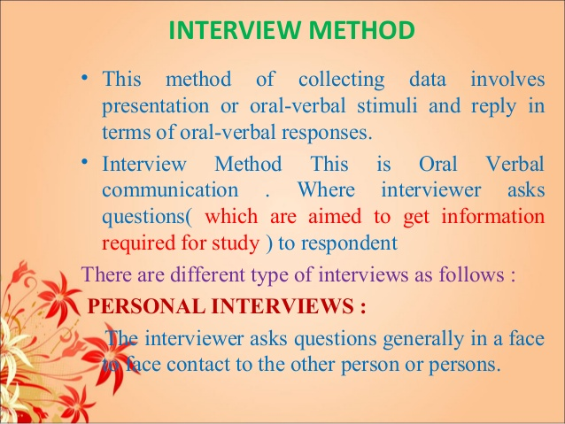

Slide 6
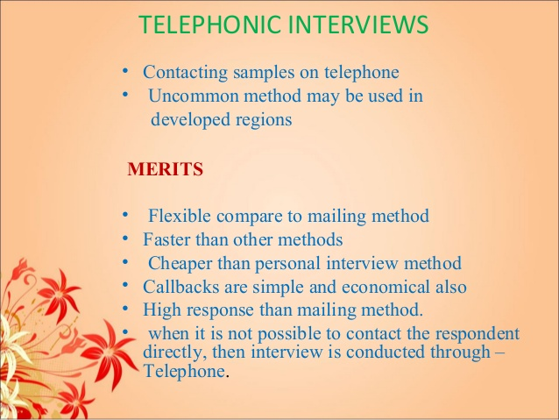

Slide 7
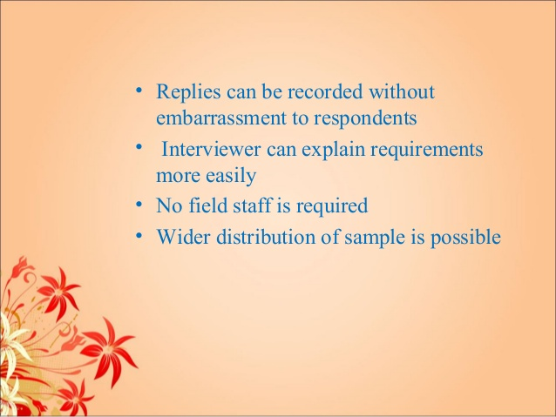

Slide 8
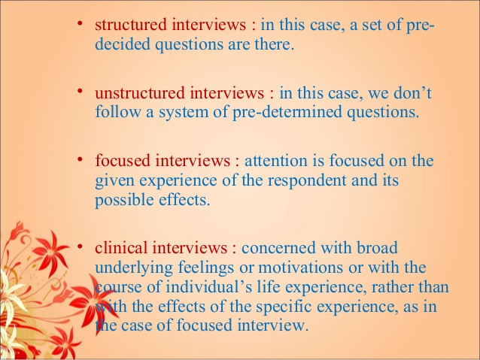

Slide 9
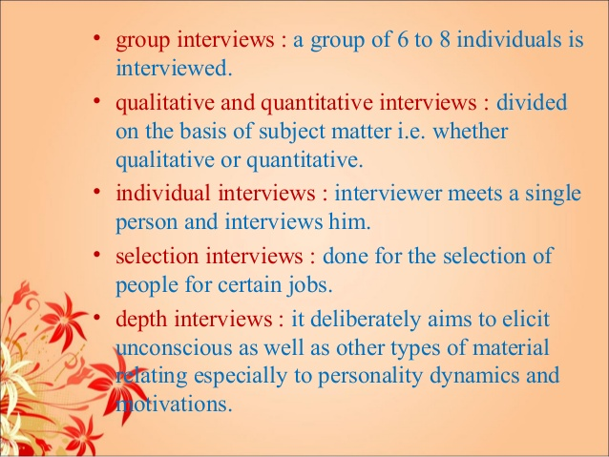

Slide 10
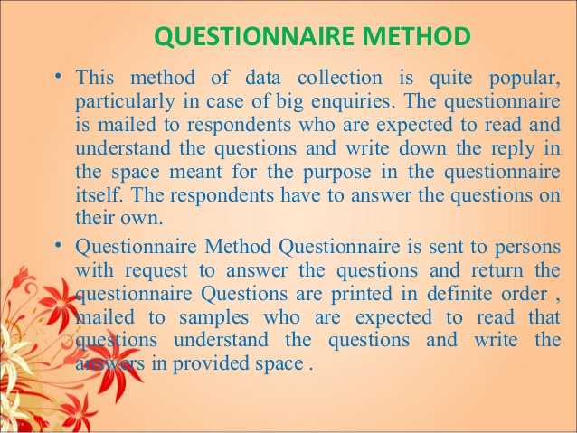

Slide 11
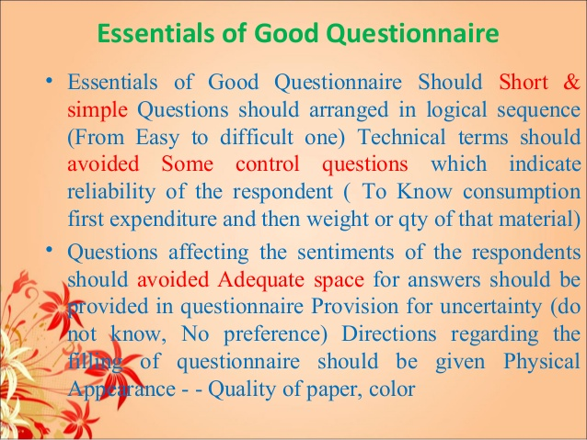

Slide 12
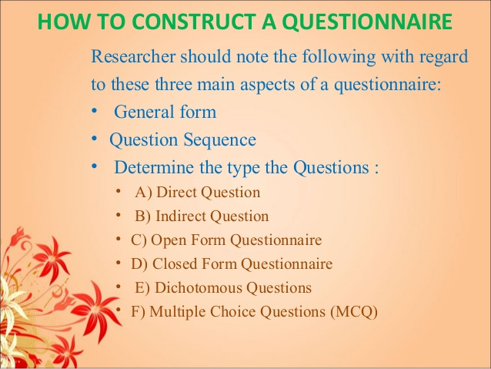

Slide 13
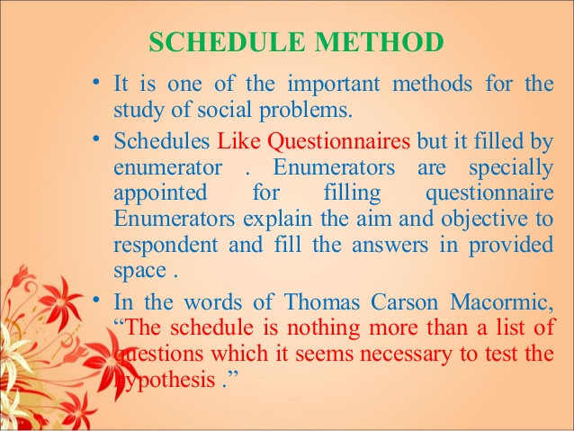

Slide 14
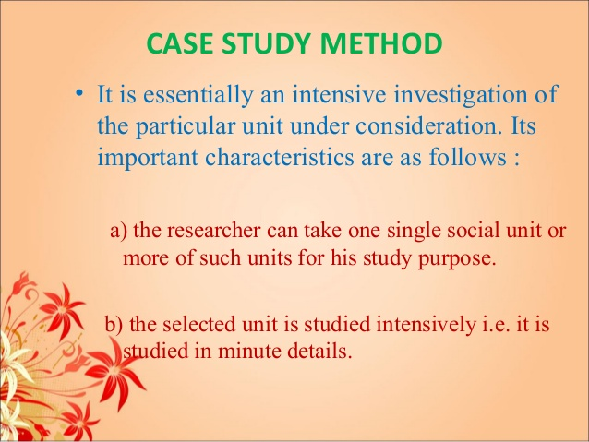

Slide 15
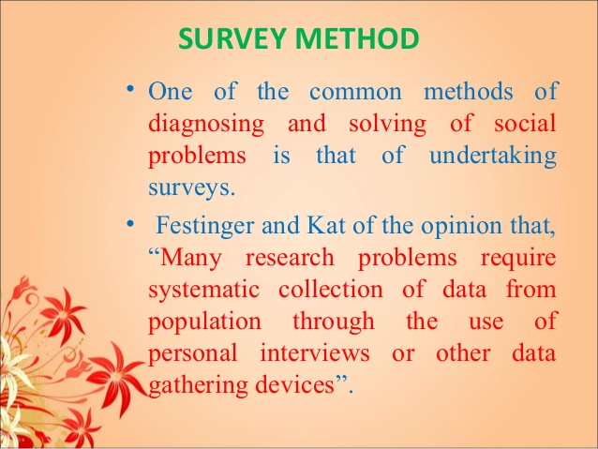

Slide 16
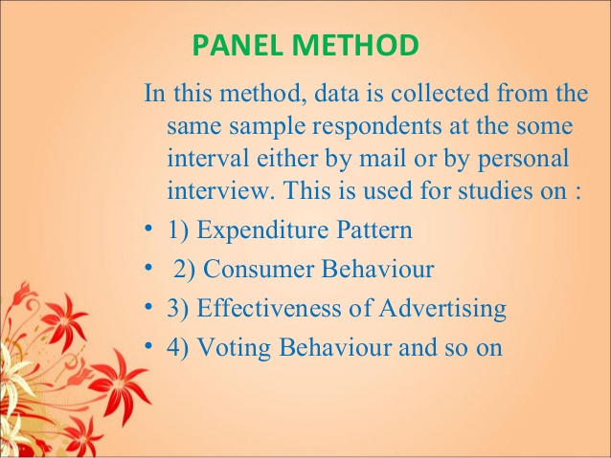

Slide 17
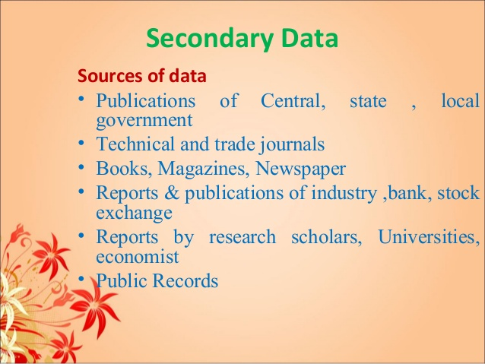

Slide 18
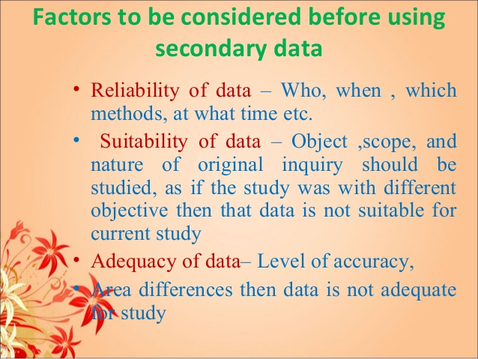

Slide 19
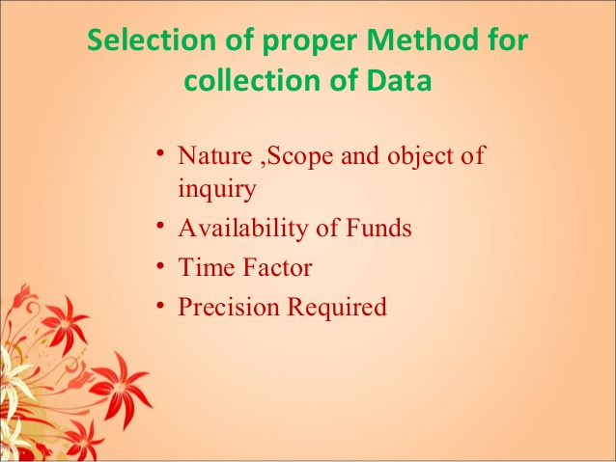

Slide 20
PROCESSING OPERATIONS OF DATA
Editing of data
Coding
Classification
Tabulation
Editing : editing data means correcting, modifying the raw data to ensure that information is available correctly, adequately & relevant

Slide 21
Stages of editing: 1) field editing 2) office editing
CODING : coding is must to answer the questions into meaningful categories. In that we can use symbols, numbers, lines etc.
Essential of coding:
Appropriate to research problem
Exhaustive
Mutually Exclusive

Slide 22
Procedure of Coding:
Identification of open coding
Axial coding
Selective coding
CLASSIFICATION OF DATA
It is the process to classify the data according to requirement or large number of raw data which must be reduced into homogeneous group if it get meaningful relationship.

Slide 23
Types Of Classification
Classification according to Attributes.
Classification according to Class interval
TABULATION
It is the broadest form of an orderly arrangement of data in columns and rows.

Slide 24
Types of Tables:
Types of Tables
Simple &
Complex
Simple & one way tables
Two way tables
General & Special
Higher order table

Slide 25


